Slide 1
Managing Projects with Microsoft 365

Slide 2

Managing projects and tasks

Slide 3

Christine Matheney
Senior Program Manager

Slide 4



In this course:
Microsoft Lists
Planner
Project

Slide 5
Managing Projects with Microsoft 365

Slide 6
Why Use Microsoft Lists?

Slide 7
In this lesson:
Using Microsoft Lists

Slide 8
Why Use Microsoft Lists?
Organization

Slide 9
Why Use Microsoft Lists?
Availability

Slide 10
Why Use Microsoft Lists?
Integration

Slide 11

Try out Microsoft Lists
Improve your organization
Access from multiple devices
Utilize program integrations

Slide 12
Navigating Microsoft Lists

Slide 13
In this lesson:
Accessing your lists in Microsoft Lists

Slide 14
Navigate Your Lists
Favourite important lists
Filter recents
View all lists

Slide 15
Creating your First List

Slide 16
In this lesson:
Creating a list

Slide 17
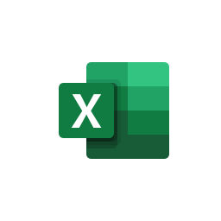

Creating a list from:
Blank List
Excel
An existing list
A template

Slide 18
Make your own list
Customize columns
Add items
Reorder items

Slide 19
Creating Lists from Excel

Slide 20
In this lesson:
Importing existing data into lists

Slide 21
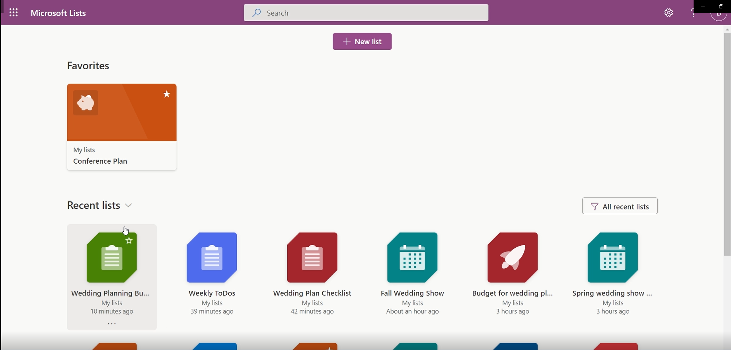
Exercise Files > Wedding Plan Checklist.xlsx

Slide 22
Create a list from Excel
Import data from Excel
Customize list columns

Slide 23
Creating Lists from a Template

Slide 24
In this lesson:
Using templates

Slide 25
Create a list from a Template
Explore templates
Import data
Customize columns

Slide 26
Sharing Your Lists

Slide 27

In this lesson:
Sharing lists with team members

Slide 28
Sharing a List
With a specific person
To anyone with a link

Slide 29
Control your lists
Send to a colleague
Restrict editing to specific people
Allow anyone to view

Slide 30
Optimizing Lists for Projects

Slide 31
In this lesson:
Using features in Lists

Slide 32
Optimize your lists
Create columns
Add item due dates
Customize list views

Slide 33
Why Use Planner?

Slide 34
In this lesson:
The benefits of Microsoft Planner

Slide 35
Try out Planner
Improve your organization
Easily see your timelines
Keep track of tasks

Slide 36
Navigating Microsoft Planner

Slide 37
In this lesson:
Understanding Microsoft Planner

Slide 38

Navigate Planner
View assigned tasks
See recent plans
Note due plans
Sort by priority

Slide 39
Creating a Plan

Slide 40
In this lesson:
Creating your first plan
Organizing tasks
Assigning tasks

Slide 41

Create a Plan
Organize tasks by buckets
Assign tasks to team members
Add due dates to tasks
Prioritize tasks by importance

Slide 42
Manage Tasks in Planner

Slide 43
In this lesson:
Managing tasks in Planner

Slide 44
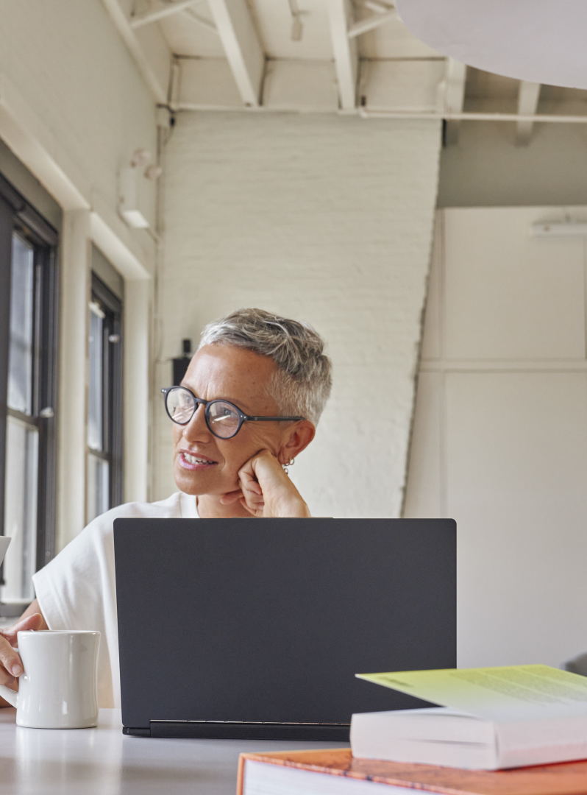
Manage Your Tasks with Planner
View tasks assigned to you
Assign tasks to team members
See tasks in schedule view
Schedule due dates

Slide 45
Sharing and Updating Plans

Slide 46
In this lesson:
Communicating updates

Slide 47
Update and share your plans
Customize plan settings
Change plan layout
Adjust team notifications
Share your plan

Slide 48
Planner Pro Tips

Slide 49
In this lesson:
Getting the most out of Planner

Slide 50
Planner pro tip
Add attachments to keep relevant documents with your tasks

Slide 51
Planner Pro Tip
Add checklist items to tasks for step that are smaller

Slide 52
Planner Pro Tip
Copy a task instead of creating a task from scratch

Slide 53

Follow Planner Best Practices
Use checklists
Add attachments
Try duplication

Slide 54
Why use Project?

Slide 55
In this lesson:
Exploring key features in Project

Slide 56
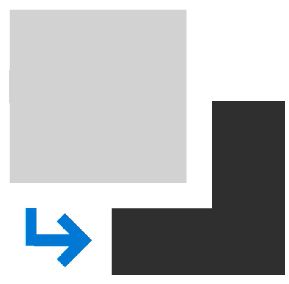
Tasks Dependencies
The relationship between tasks that are reliant on another to be completed.

Slide 57
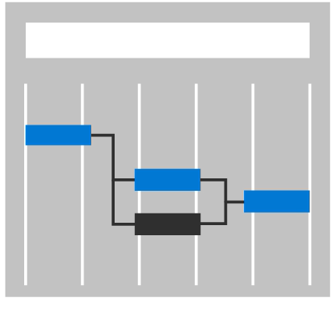
Critical Path
Tasks that control the finish date of the project.

Slide 58

Try Out Projects
Improve your organizing
Easily see your timelines
Keep track of tasks

Slide 59
Navigating Your First Project

Slide 60
In this lesson
Locating key features in Project

Slide 61

Navigate Microsoft Project
Explore the interface
Mark your favorites
View your shared projects

Slide 62
Creating Your First Project

Slide 63
In this lesson
Creating a framework for projects

Slide 64
Waterfall
A sequenced project management system where work is completed in ordered phases

Slide 65
Agile
A flexible project management system where the team works through a backlog of tasks during time-bound sprints

Slide 66

Create Your own project
Select a management process
Create a blank project
Add buckets and tasks

Slide 67
Building Your Project Plan

Slide 68
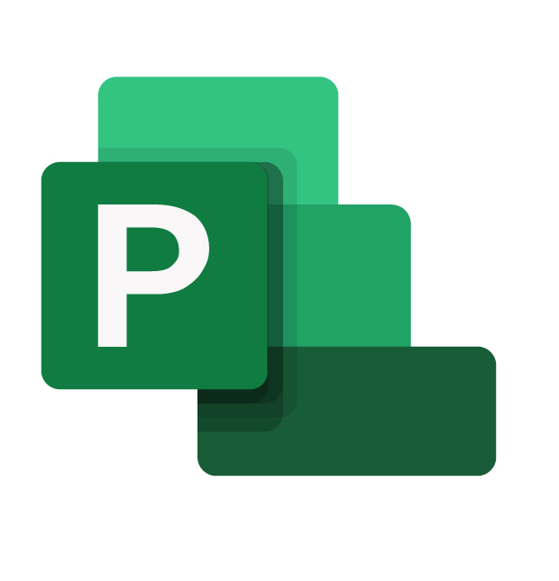
In this lesson
Adding tasks
Assigning tasks
Setting start and end dates

Slide 69

Make a project plan
Add tasks
Assign tasks
Set durations
View timeline

Slide 70
Organizing Your Work

Slide 71
In this lesson:
Adding subtasks and dependencies

Slide 72

Organize Your projects
Add tasks
Add subtasks
Create dependencies

Slide 73
Project Pro Tips

Slide 74
In this lesson
Changing dates
Attaching files
Adding custom columns

Slide 75
Project Pro Tip
You’re able to adjust your project start date if timelines change

Slide 76
Project Pro Tip
Attach files to keep your project assets organized

Slide 77
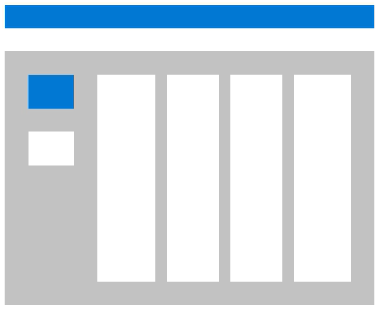
Project Pro Tip
Add custom columns to tasks.

Slide 78

Project Best Practices
Modify start dates
Upload attachments
Add custom columns

Slide 79
Managing Projects with Microsoft 365

Slide 80
Project Management Tools
Lists
Planner
Project

Slide 81
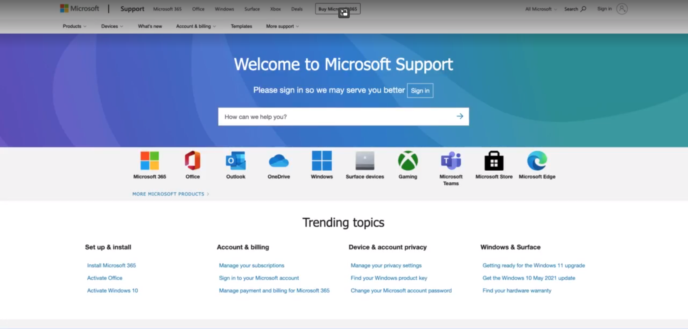
https://support.microsoft.com/

Slide 82
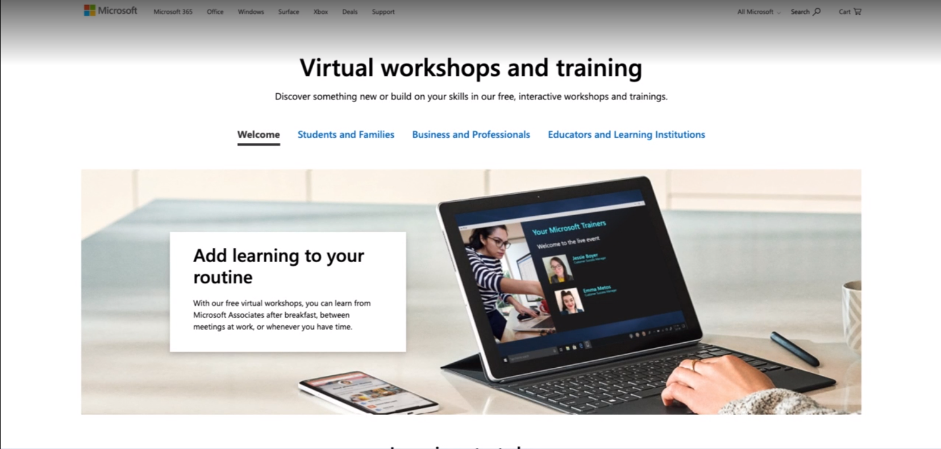
https://www.microsoft.com/en-us/store/workshops-training-and-events/

Slide 83
Managing Projects with Microsoft 365

